Slide 1
Music player
Erasmus+ project for Android

Slide 2
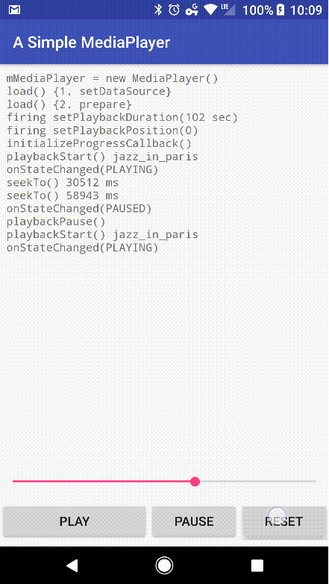
Beginning
We came up with the idea of creating a music player app when we found this simple media player sample on GitHub
It had few features, such as loading mp3 files from a static source, pausing (and resuming), and a seek-bar
We decided to use this as a base and add our own features, such as:
A good looking, easy to use UI
Importing own songs

Slide 3
Work
Since we had a group of 4, we split the project into 4 main parts:
ListViewActivity code
ListViewActivity layout
SongPlayActivity code
SongPlayActivity layout

Slide 4
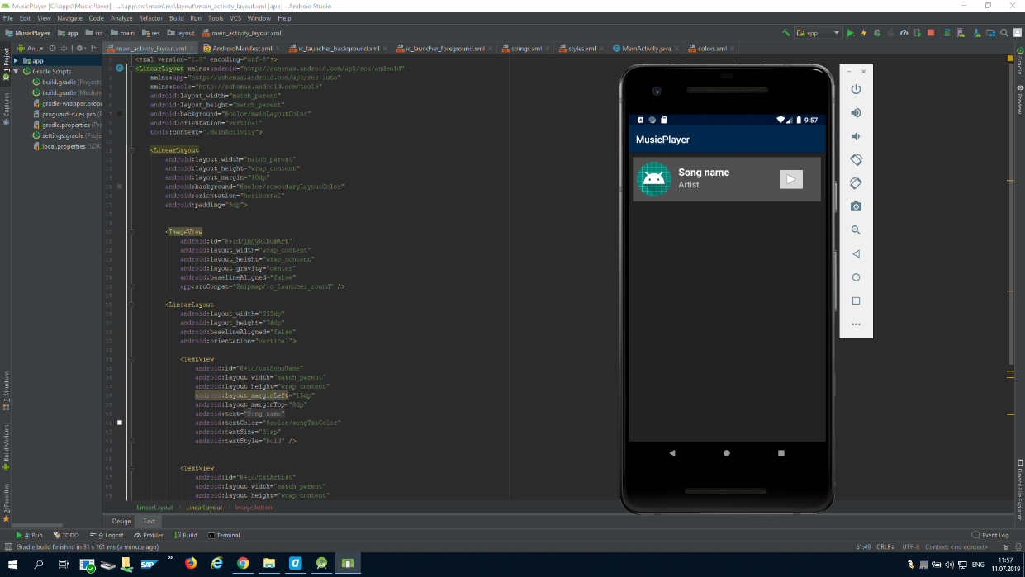
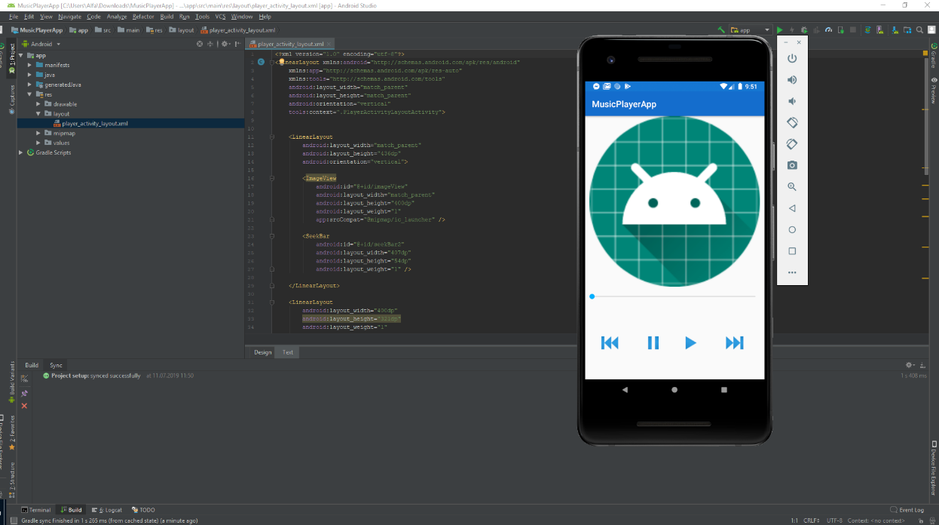
ListView
SongPlay

Slide 5
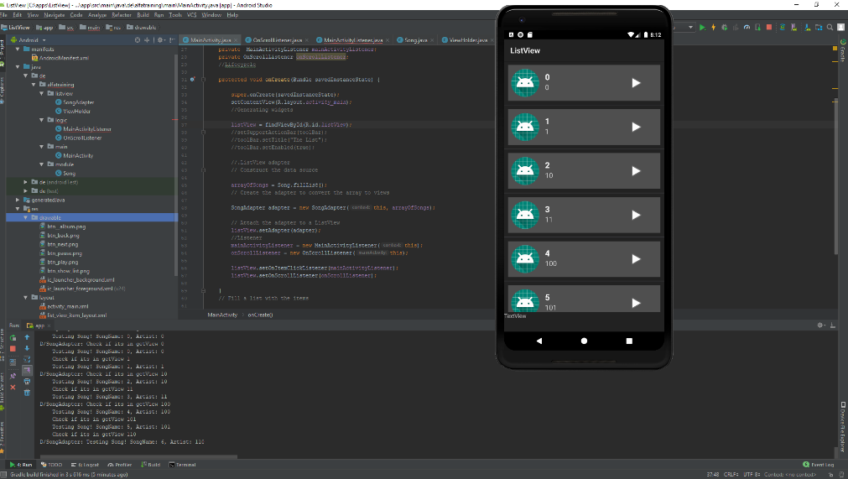
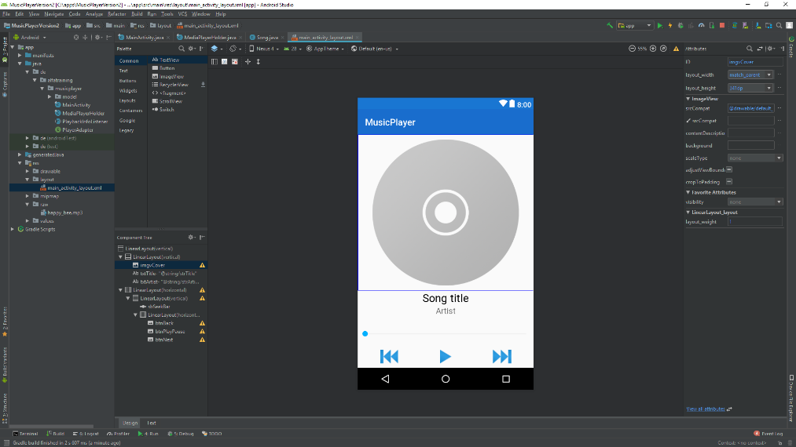
Coding day one of two
On the ListViewActivity tab, the scrollview was implemented with test data for the artist’s names and song’s names. A static bar at the bottom of the screen was created for later uses (showing the current playing song and by clicking on it showing the other activity).
On the SongPlayActivity tab, the github project was succesfully implemented to our project. The buttons were changed to imagebuttons, the mediaplayer controlling functions were changed to get songs from the phone's music folder, a function to get metadata was made, and the layout was updated so the metadata could be shown.

Slide 6
Coding day two of two
During day two we did some finishing touches on both activities (ListlViewActivity had the media buttons implemented, while on SongPlayActivity a permission issue was fixed and some design changes were made) and we started to merge them together.

Slide 7
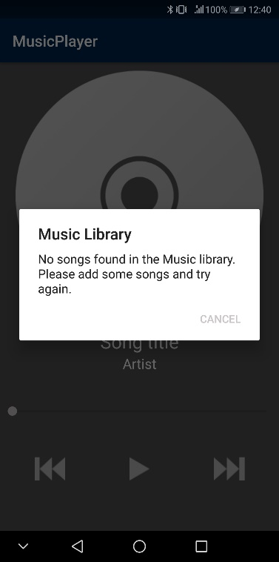
How to import downloaded songs
Downloaded songs need to be on the phone’s internal storage in the “Music” folder (no subfolders are allowed).
When you enter the app, your songs will be automatically imported. (If there are no songs in the designated folder, the app will display an alert dialog)

Slide 8
Things we learned
Working as a team
Useful programming skills
Managing time
Refining our understanding of different things through discussions and explanations

Slide 9
Thanks for the attention!
Nagy Szabolcs
Dávid Arthur
Kaffai Levente
Magyarosi Péter

